Slide 1
Objectives
In this session, you will learn to:
  Record excise transactions for dealers
  Create excise invoice

Slide 2
Recording Transactions
According to the provisions mentioned in the Central Excise Rules, 2002, a Selling Dealer is eligible to pass CENVAT Credit to the purchasing dealer provided they are registered.
A sale should be made under the cover of an invoice issued in terms of the provisions of Central Excise.

Slide 3
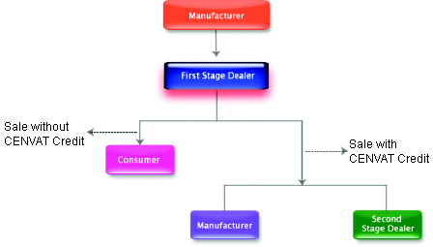
Recording Transactions (Contd.)
The following figure shows the flow of purchases from manufacturer.

Slide 4
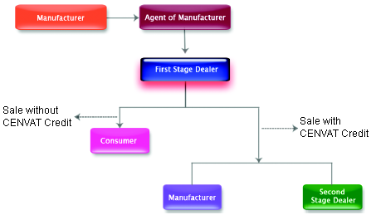
Recording Transactions (Contd.)
The following figure shows the purchase from agent of manufacturer.

Slide 5
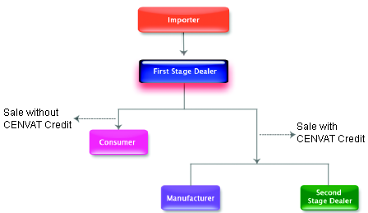
Recording Transactions (Contd.)
The following figure shows the purchase from importer.

Slide 6
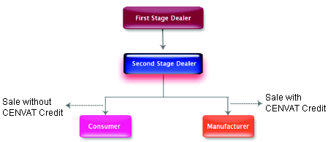
Recording Transactions (Contd.)
The following figure shows the purchases from first stage dealer.

Slide 7
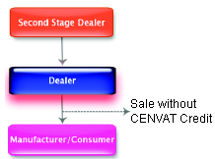
Recording Transactions (Contd.)
The following figure shows the purchases from the second stage dealer.

Slide 8


Demo: Creating Excise Purchases
Problem Statement:
  On the April 10, 2009, Monnet Ispat & Energy Ltd. purchased the following goods from Bhargavan Steels (Manufacturer) vide B.No. BS/101.

Slide 9

Demo: Creating Excise Purchases (Contd.)
Let us see how to create Excise
Purchases in Tally.ERP 9.

Slide 10
Excise Invoicing
Tally.ERP 9 allows you to generate and print Cenvat Invoices in the prescribed format besides a Non-Cenvatable Invoice.
The following mandatory stipulations on the preparation of Cenvat Invoices are met by Tally.ERP 9:
  The fields pre-printed on the Invoice are:
    Name, Address and Central Excise Registration number of the registered location issuing the invoice
    Name of the jurisdictional range or Division or Commissionerate
    Company’s Income Tax Number and Sales Tax Registration Number
Notes:
Share the session objectives with the students.

Slide 11
Excise Invoicing (Contd.)
  The mandatory four copies are prepared and each copy is marked as:
    Original copy marked as Original for a Buyer.
    Duplicate marked as Duplicate for Transporter (to be used for availing Cenvat credit).
    Triplicate marked as Triplicate for Central Excise.
    Quadruplicate marked as Quadruplicate for a Registered person.
  The copies of the invoices issued by a first stage dealer and a second stage dealer are marked as First Stage Dealer and Second Stage Dealer respectively.
  The dealer is required to issue only one invoice per consignment.
  Each Cenvat Invoice issued by the location bears a printed serial number, beginning from the 1st of April of the year.
  Records and Invoice generated through computer are also recognised.
Notes:
Share the session objectives with the students.

Slide 12

Demo: Creating Excise Sales Invoice
Problem Statement:
  On April 15, 2009, Monnet Ispat & Energy Ltd., sold the following goods to Jaykanth Engineering, Bangalore.

Slide 13
Demo: Creating Excise Sales Invoice (Contd.)
Let us see how to create
Excise Sales Invoice in
Tally.ERP 9.

Slide 14
Summary
In this session, you learned that:
  Tally.ERP 9 permits you to generate and print both Cenvatable and Non-Cenvatable Sales Invoice.
  A Registered Dealer is required to maintain Statutory Reports like Stock Register of the cenvatable goods and Quarterly Return of the Excise Duty paid. Tally.ERP 9 permits you to generate and print these Statutory Reports.

